Slide 1
Computer vision: models, learning and inference
Chapter 2
Introduction to probability

Slide 2

What color are stop signs?
Photo by JaypeeOnline (copyright, all rights reserved)

Slide 3
Random variables
A random variable x denotes a quantity that is uncertain
May be result of experiment (flipping a coin) or real world measurements (measuring temperature)
Observing more instances of x, we get different values
Some values occur more than others and this information is captured by a probability distribution

Slide 4
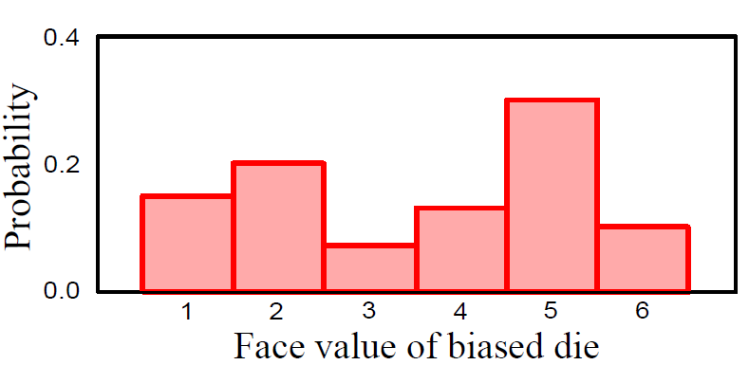
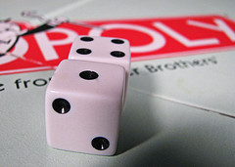
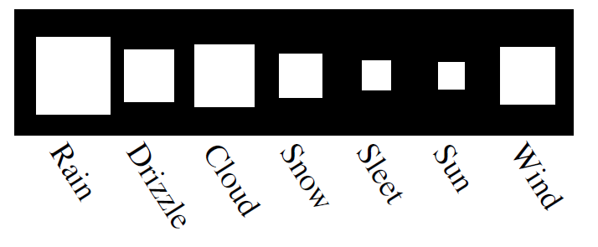
Discrete Random Variables
Photo by DaylandS

Slide 5
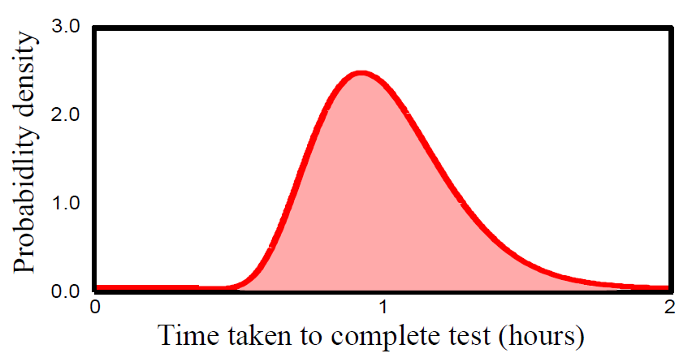
Continuous Random Variable

Slide 6
Joint Probability
Consider two random variables x and y
If we observe multiple paired instances, then some combinations of outcomes are more likely than others
This is captured in the joint probability distribution
Written as Pr(x,y)
Can read Pr(x,y) as “probability of x and y”

Slide 7
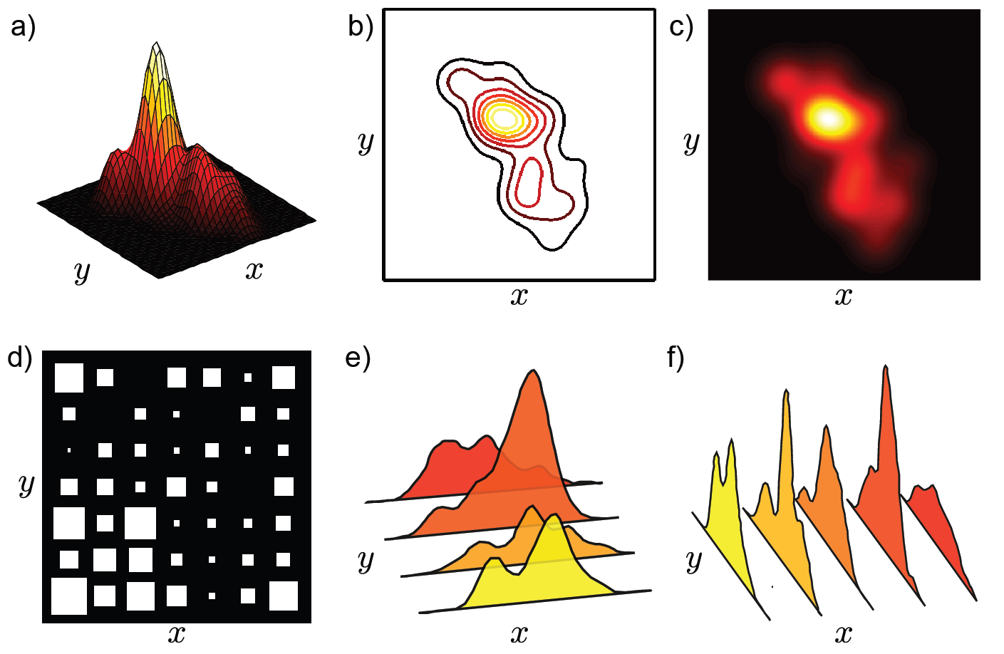
Joint Probability

Slide 8
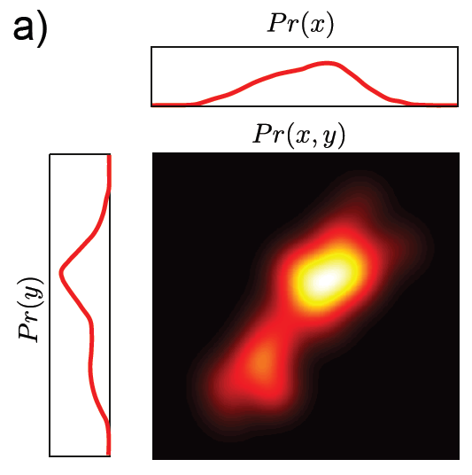
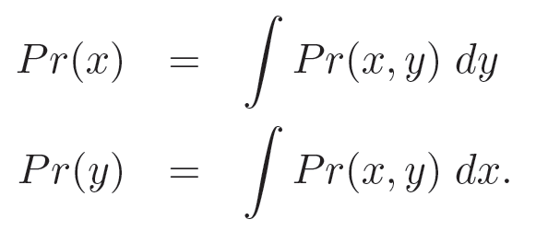
Marginalization
We can recover the probability distribution of any variable in a joint distribution by integrating (or summing) over the other variables

Slide 9
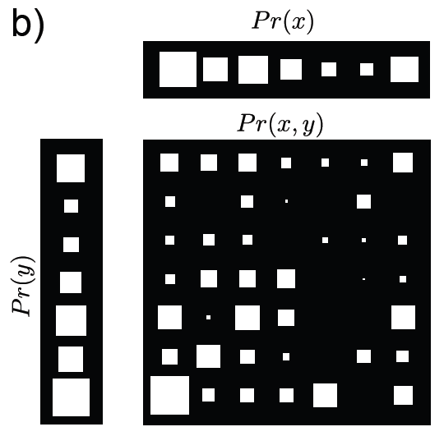
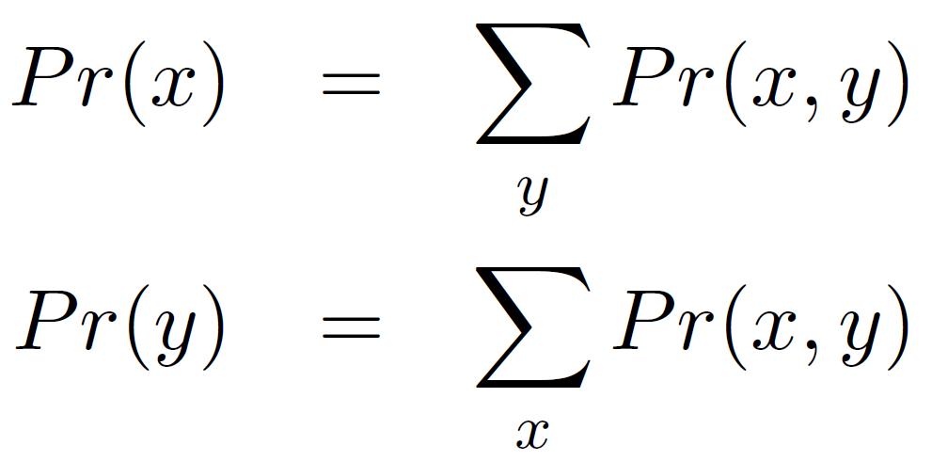
Marginalization
We can recover the probability distribution of any variable in a joint distribution by integrating (or summing) over the other variables

Slide 10
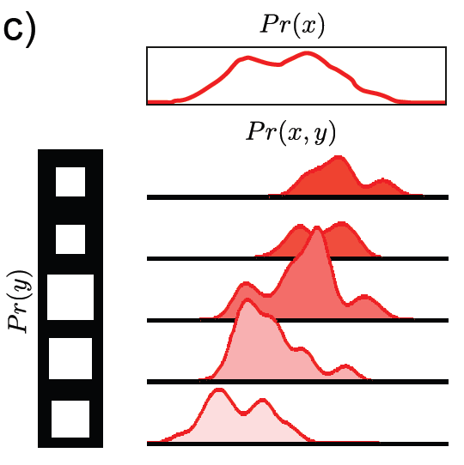
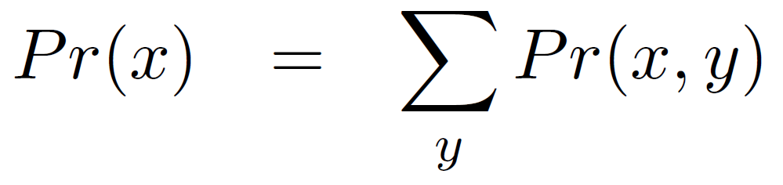
Marginalization
We can recover the probability distribution of any variable in a joint distribution by integrating (or summing) over the other variables

Slide 11
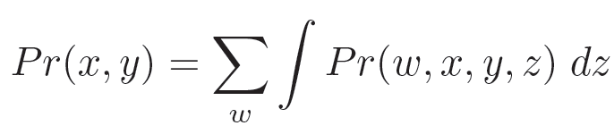

Marginalization
We can recover the probability distribution of any variable in a joint distribution by integrating (or summing) over the other variables
Works in higher dimensions as well – leaves joint distribution between whatever variables are left

Slide 12
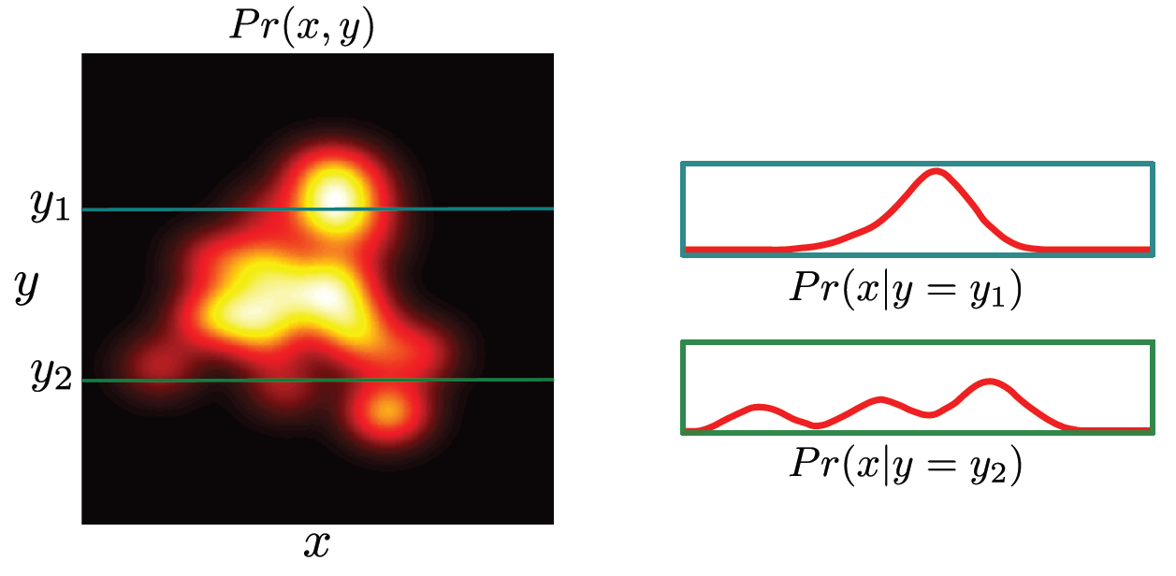
Conditional Probability
Conditional probability of x given that y=y₁ is relative propensity of variable x to take different outcomes given that y is fixed to be equal to y₁.
Written as Pr(x|y=y₁)

Slide 13
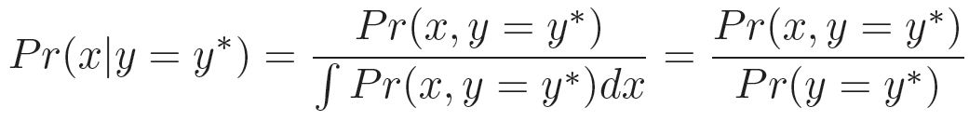
Conditional Probability
Conditional probability can be extracted from joint probability
Extract appropriate slice and normalize

Slide 14
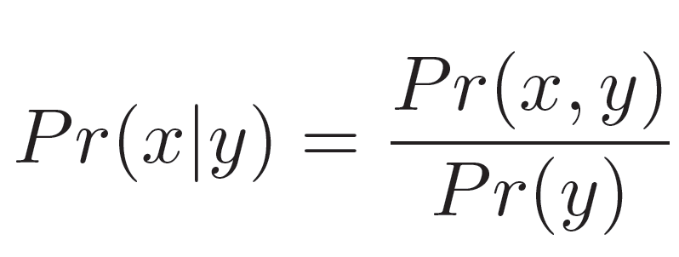
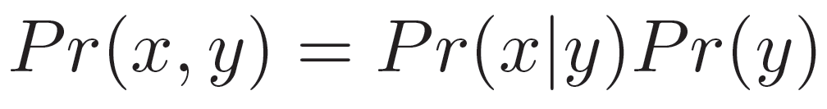
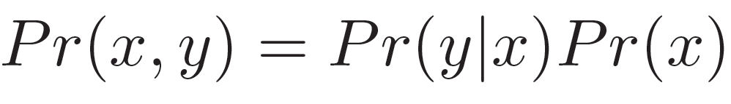
Conditional Probability
More usually written in compact form
Can be re-arranged to give

Slide 15
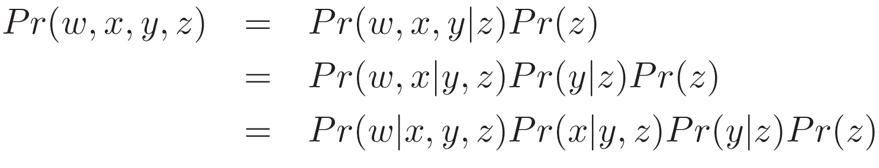

Conditional Probability
This idea can be extended to more than two variables

Slide 16

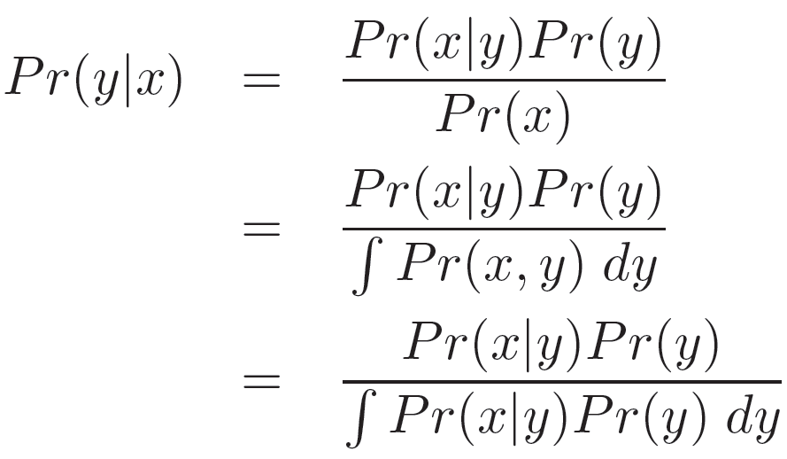


Bayes’ Rule
From before:
Combining:
Re-arranging:

Slide 17

Bayes’ Rule Terminology
Likelihood – propensity for observing a certain value of x given a certain value of y
Prior – what we know about y before seeing x
Evidence –a constant to ensure that the left hand side is a valid distribution
Posterior – what we know about y after seeing x

Slide 18
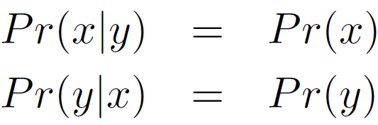
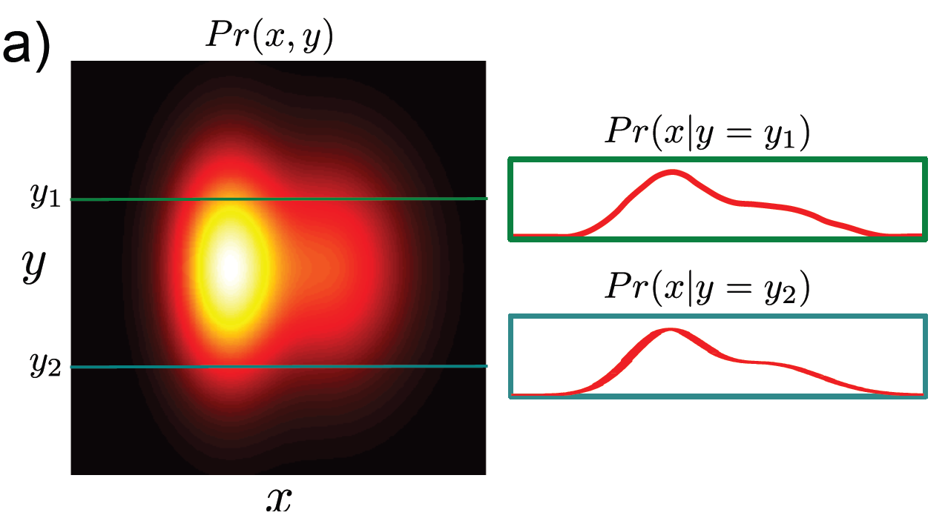
Independence
If two variables x and y are independent then variable x tells us nothing about variable y (and vice-versa)

Slide 19
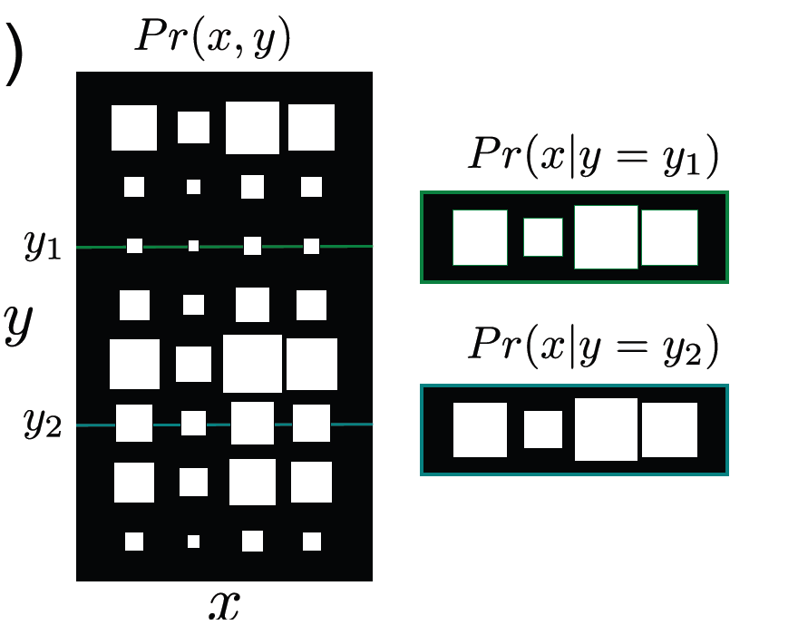
Independence
If two variables x and y are independent then variable x tells us nothing about variable y (and vice-versa)

Slide 20
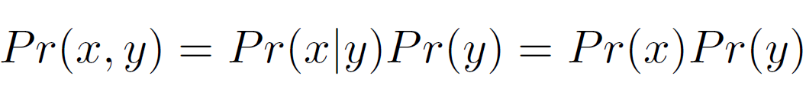
Independence
When variables are independent, the joint factorizes into a product of the marginals:

Slide 21
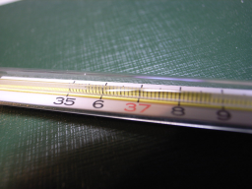
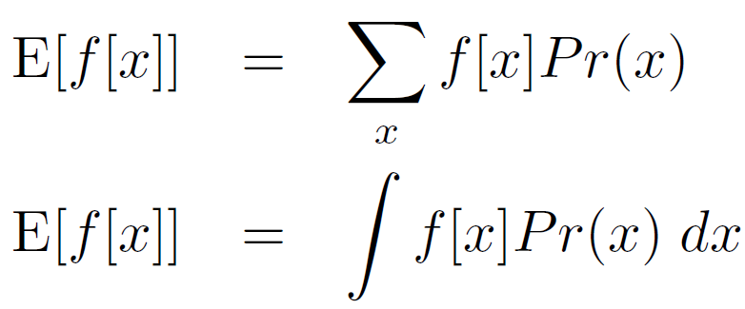

Expectation
Expectation tells us the expected or average value of some function f [x], taking into account the distribution of x
Definition:
"Thermometer" by matsuyuki is licensed under CC BY-SA 2.0

Slide 22
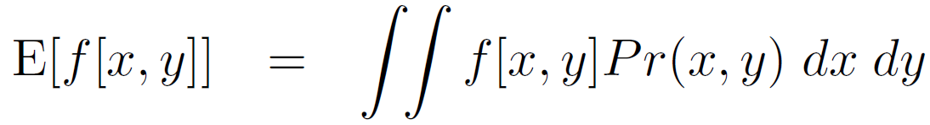
Expectation
Expectation tells us the expected or average value of some function f [x], taking into account the distribution of x
Definition in two dimensions:

Slide 23
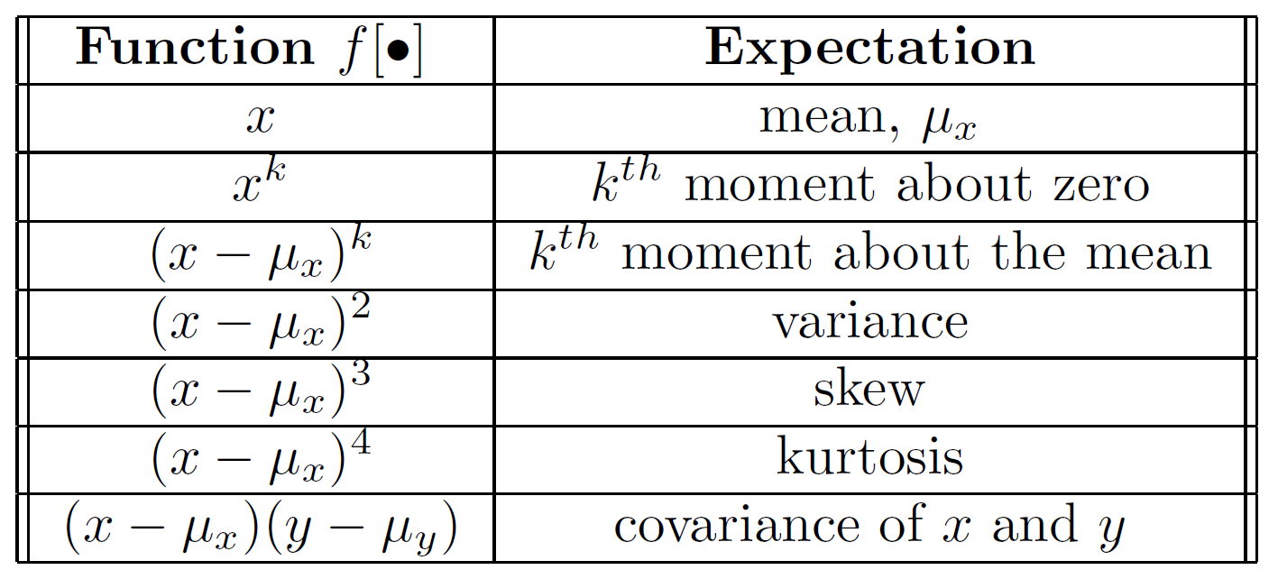
Expectation: Common Cases

Slide 24
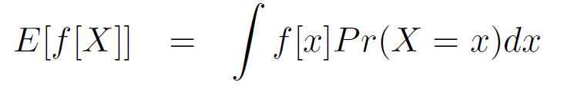

Expectation: Rules
Rule 1:
Expected value of a constant is the constant

Slide 25

Expectation: Rules
Rule 2:
Expected value of constant times function is constant times expected value of function

Slide 26
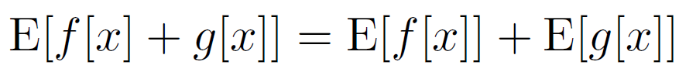
Expectation: Rules
Rule 3:
Expectation of sum of functions is sum of expectation of functions

Slide 27
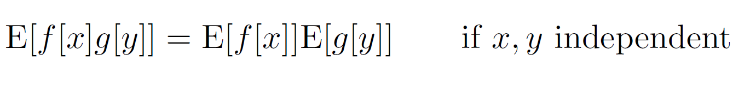
Expectation: Rules
Rule 4:
Expectation of product of functions in variables x and y
is product of expectations of functions if x and y are independent

Slide 28
Conclusions
Rules of probability are compact and simple
Concepts of marginalization, joint and conditional probability, Bayes rule and expectation underpin all of the models we use
One remaining concept – conditional expectation – discussed later

